Slide 1
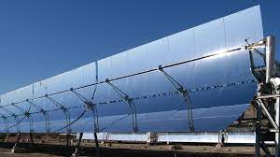
Performance Analysis of Parabolic Trough Collector

Slide 2
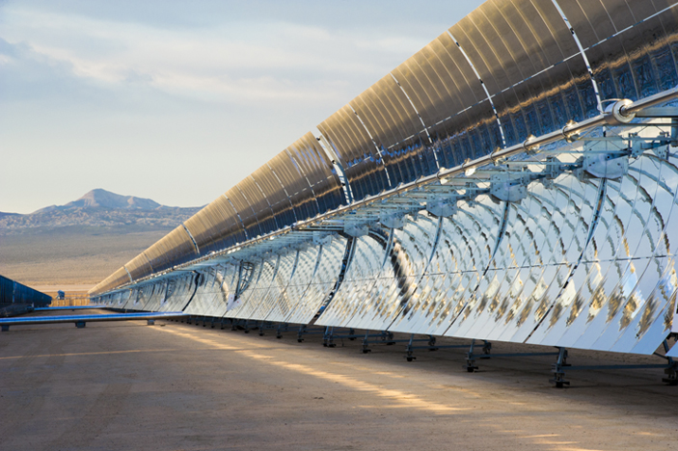
Introduction
Parabolic trough collectors are formed by a cylindrical surface of mirrors with a parabolic shape that concentrates solar radiation on a receiver tube located at the focal point of the parabola. A fluid, normally synthetic oil, circulates inside the receiver tubes and is heated up by the sun (around 400 ºC). The fluid is then pumped through heat exchangers to generate steam which is thus used to produce electricity in a conventional turbine.

Slide 3
Purpose
Solar radiation reaches the Earth's upper atmosphere with the power of 1366 watts per square meter (W/m2). Many technologies have been developed to make use of solar radiation. Some of these technologies make direct use of the solar energy (e.g. to provide light, heat, etc.), which helps us to generate electricity.
But in order to generate higher temperatures with good efficiency a solar collector in the form of a parabolic trough reflector can be productive. The parabolic trough reflector is a solar thermal energy collector designed to capture the sun’s direct solar radiation over a large surface area and focus, or more generally “concentrate it” onto a small focal point area increasing the intensity of solar energy received at the focal point.

Slide 4
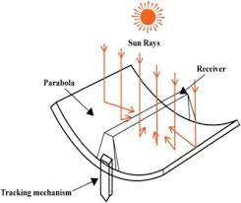
Principle
A parabolic trough solar collector (PTC) takes the radiant energy from the sun and converts it to useful thermal energy in the heat transfer fluid (HTF) that circulates through the solar field.

Slide 5
Construction
A parabolic trough concentrator consists of a reflecting surface mounted on a reflector support structure having the profile of a parabola.
A receiver assembly comprising a circular absorber tube with suitable selective coating and enclosed in a concentric glass envelope is centered along the reflector focal line.
With suitable end supports, the PTC module is supported on two bearings mounted on two pylons. It is also provided with a precise driving system in order to track the sun and thus to maintain focusing of the solar radiation on the receiver assembly.
The incident energy is absorbed by a working fluid circulating through the absorber tube. The various subsystems of a PTC are reflector, reflector support structure, receiver and tracking 28 devices.

Slide 6
Parameters
Aperture area (Aa): It is the plane opening of the concentrator through which the incident solar flux is accepted. For a cylindrical or linear concentrator it is characterized by the width, while for a surface of revolution it is characterized by the diameter of opening. | Local Concentration Ratio: It may so happen that the absorber in some systems may not be fully or uniformly illuminated, thus in order to characterize this local concentration this term is defined. It is defined as the ration of flux arriving at any point on the absorber to the incident flux at the entrance aperture of the concentrating system.
Absorber Area (Aabs): It is the total area receiving the concentrated radiation. It is also the area from which useful energy is delivered to the system. | Intercept factor (Y): It is the fraction of focused energy intercepted by the absorber of a given size. For a typical concentrator receiver design 29 its value depends on the size of absorber generally is has a value greater than 0.9. However if the radiation is normal to the aperture, its value is 1.
Acceptance Angle (2ɵc): It is the limiting angle over which incident ray path may deviate from normal to the aperture plane and still reach the absorber. Concentrators with large acceptance angle need to be moved on seasonally while concentrators with smaller acceptance angle need to be moved continuously to track the sun. | Collector (Thermal) Efficiency (ƞc): It is the ratio of the useful energy delivered to the absorber to the energy incident on the aperture.
Geometric Concentrating Ratio (CR): It is the ratio of effective area of the aperture to the surface area of the absorber. Value of concentrating ratio varies from 1 (limiting value for a flat plate collector) to few thousand (for a parabolic collector). | Optical Efficiency (Ƞo): It is defined as the ratio of the energy absorbed by the absorber to that incident on the collector. It includes the effect of mirror surface, shape, transmission losses, tracking accuracy, shading by receiver, absorption and reflection properties, solar beam incident angle.

Slide 7
Performance Analysis

Slide 8
Components involved
The main component of the experimental setup and the constructional detail of the setup are described below:
Parabolic Trough
Collector Plates
Copper Tubes
Glass Cover
Focusing Mirror
Thermocouple

Slide 9
Applications

